Slide 1

CU Data Week January 31- February 5
Sponsored by the Biostatistics, Epidemiology, and Research Design (BERD) core of the CCTSI.​
Notes:
Camille

Slide 2
StatsTalks
1/31 12-1 pm: Basic Statistics Using R
1/31 5-6 pm: Creating Cool Figures in R
2/1 12-1 pm: Basic Statistics Using SAS
2/1 5-7 pm: Analysis Workflow Using Git, Python, and Jupyter
2/2 5-6 pm: Introduction to Microbiome Data
2/3 12-1 pm: Working with a Statistician
Notes:
Camille

Slide 3
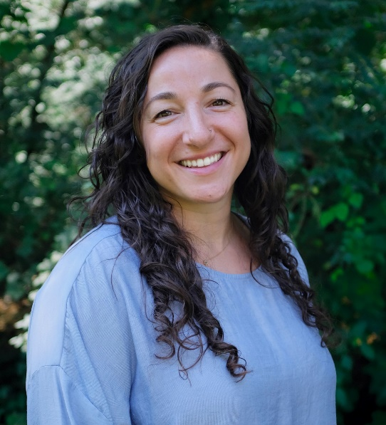
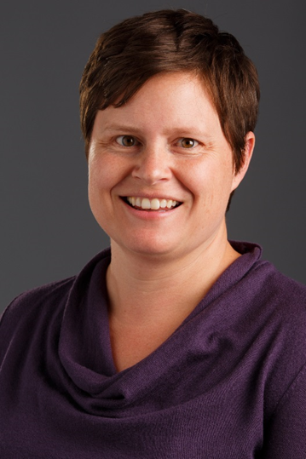
Tips for working with a biostatistician
Camille Hochheimer, PhD
Research Associate
Biostatistician and Consulting Manager
Sarah Schmiege, PhD
Research Associate Professor
Notes:
Camille

Slide 4
Poll: Who is in the audience?
MS/PhD Student in Biostatistics & Informatics
MS/PhD Student in other department
MPH Student in Applied Biostatistics
MPH Student in other concentration
Clinical faculty or trainee
Faculty biostatistician
Other
Notes:
Camille

Slide 5
Goals
Discuss different models of statistical support
How to find and nurture a relationship with a statistician
For non-statisticians: Understand when and how to include a statistician in your research team
For statisticians: Understanding your responsibilities and goals as a statistician
Notes:
Camille

Slide 6
Types of statistical support
Team Science
Statistical Collaboration
Statistical Consulting
Notes:
Sarah

Slide 7
Consulting vs. Collaboration
Consulting
Short-term with fixed amount of work and well-defined endpoints
Examples:
Feedback on study design
Small, well-defined research project
Hourly payment
Drawback: consultant may not be invested/involved through entire length of project (e.g., study design)
Collaboration
Statistician is involved in all stages of the project, from study design, to data collection, to final analyses
Examples:
Involved from grant development stage through to the dissemination of study findings
Involved in manuscript from analysis plan to final write-up
At its best, this is a mutually beneficial relationship
Notes:
Sarah

Slide 8
Poll: What have been your past interactions with/as a biostatistician?
I have consulted with/as a biostatistician
I have collaborated with/as a biostatistician
I have both consulted & collaborated with/as a biostatistician
I have neither consulted nor collaborated with/as a biostatistician
Notes:
Sarah

Slide 9
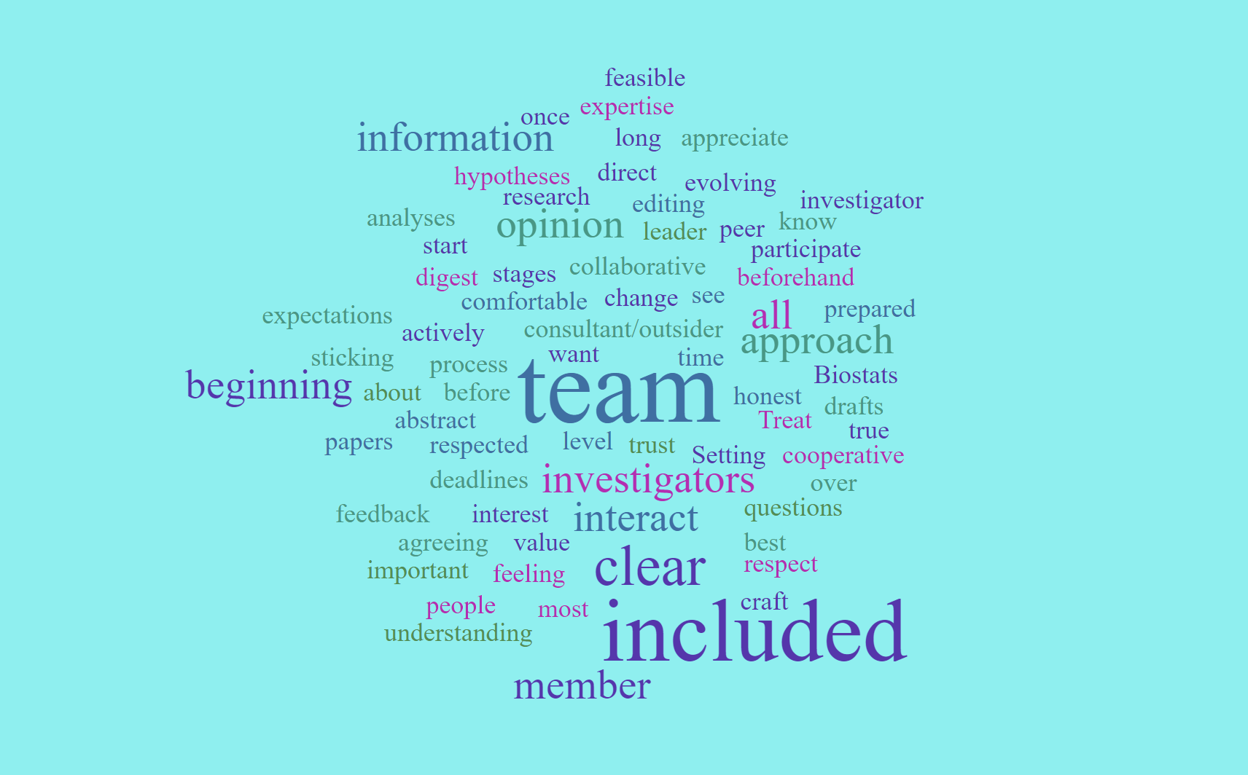
How do biostatisticians describe their ideal collaboration?
Notes:
Sarah

Slide 10
When do you need a statistical consultant?
You want help to design a study to answer your research question
You want to determine how many subjects/samples you need to collect and how many groups you should compare
You are working with methods or types of data with which you are unfamiliar
You have a volume of data you cannot handle yourself (e.g., EHR data)
You want to use the latest methods for design or analysis
“When you consult a statistician, you enlist the help of a professional who is particularly skilled at solving research problems. The statistician will try to guide you to the best way to obtain an answer to your research questions” -ASA
The American Statistical Association. When you consult a statistician… what to expect. https://higherlogicdownload.s3.amazonaws.com/AMSTAT/f6e8f6fd-6343-44e2-aa52-8b4e405c5457/UploadedImages/SCSBrochure%202013.pdf
Notes:
Camille

Slide 11
Where can you find a statistician?
Statisticians, like other professionals, do not work for free! Be prepared to pay for our services.
Your department
Your collaborators’ or mentors’ statistician
Groups on campus
ACCORDS
CIDA
Children’s RI
Cancer Center
Tip: General statistical knowledge often works fine, but sometimes you need to look for a statistician with specific expertise in the methods being proposed.
Tip: Statisticians don’t know everything about anything related to numbers!
Notes:
Camille – be prepared for answering about options for student support
ACCORDS – Health services and outcome research

Slide 12
What to look for in a statistician
Good knowledge of statistics and up-to-date with current literature
Asks relevant, probing questions and is a good listener
Excellent written and oral communication
Meets deadlines and is responsive
Relevant research experience
Patient and willing/able to explain statistical concepts
Respects research ethics
The American Statistical Association. When you consult a statistician… what to expect. https://higherlogicdownload.s3.amazonaws.com/AMSTAT/f6e8f6fd-6343-44e2-aa52-8b4e405c5457/UploadedImages/SCSBrochure%202013.pdf
Notes:
Camille

Slide 13
What do you look for in a statistician?
Go to www.menti.com and enter the code 8460 2569
You can provide up to 8 words to describe what you look for in a statistician but you don’t need to provide that many
The American Statistical Association. When you consult a statistician… what to expect. https://higherlogicdownload.s3.amazonaws.com/AMSTAT/f6e8f6fd-6343-44e2-aa52-8b4e405c5457/UploadedImages/SCSBrochure%202013.pdf
Notes:
Camille

Slide 14
On working relationships
Your relationship with your statistician is just that – a relationship!
Evaluate whether your expectations on communication, behavior, funding, and authorship are aligned.
If you are not getting what you need from your statistician, talk to them!
Sometimes it’s not a good fit and you should keep looking.
Notes:
Sarah

Slide 15
On authorship
CIDA’s policy: “Any biostatistician conducting analysis, or otherwise making a significant contribution will be a co-author on the publication to acknowledge their intellectual contribution.”
First Author: Biostatistician plays major role in project development or substantially changes direction of hypothesis and corresponding analysis, provides a unique contribution, conducts analysis, and writes large portion of your paper.
Second Author: Biostatistician plays major role in project development, offers expertise needed for your research, or conducts substantial and/or complex analysis of data. Typical position for biostatistician involved in life cycle of project or with unique analytic expertise.

Slide 16
Authorship continued
Middle-Listed Author: Biostatistician does not necessarily collaborate in design of study, but conducts data analysis, writes statistical methods section, and assists in interpreting results for conclusion.
Senior Author: Biostatistician provides significant mentoring to first author, offering guidance for first author to conduct analysis, or plays major role in helping first author design the study.
Junior or student biostatisticians: Biostatistician mentored by senior statistician, senior statistician immediately follows junior statistician within authorship line (e.g., if junior statistician is second author, mentoring statistician would generally be listed as third author).

Slide 17
Scenario 1: Where should the statistician be in the authorship order?
The investigator has designed their study and collected their data. The data require some wrangling/cleaning prior to analyses.
The research question is well-defined and the analyses are standard regression approaches. The biostatistician completes a comprehensive analysis report including tables, figures, methods used, and interpretation of the findings.
The biostatistician develops appropriate manuscript-ready tables and figures, writes the “data analysis” section of the methods, and the full results section as well as provides input on the manuscript as a whole
Notes:
Sarah

Slide 18
Scenario 2: Where should the statistician be in the authorship order?
A biostatistician is brought into a project specifically because the project involves an area of analysis for which they have expertise and the analytic approach greatly benefits from their unique expertise
The biostatistician completes a comprehensive analysis report including tables, figures, methods used, and interpretation of the findings.
The biostatistician develops appropriate manuscript-ready tables and figures, writes the “data analysis” section of the methods, and the full results section as well as provides input on the manuscript as a whole
Notes:
Sarah

Slide 19
Questions your statistician will ask you about your research
What is your research question?
What is the (clinical) outcome of interest? How is it measured?
What is the population of interest?
Have these data already been collected or do they need to be collected?
What are some potential challenges?
How common is the outcome? Sample size/power issues
What patient characteristics are important to account for? Are these factors available?
Do the sickest/strongest patients get different treatment?
Notes:
Camille – does anyone have additions to this list?

Slide 20
Questions your statistician will ask about your data
Existing data vs. primary data collection
Prospective vs. Retrospective vs. Observational
How big is the population/sample with the outcome of interest?
What biases might be present in the data?
Do these data measure the outcome?
Do these data measure relevant patient characteristics and confounders?
Is there a significant amount of missing data?
How long will it take to acquire or collect these data?
Notes:
Camille – does anyone have questions to add to this list?

Slide 21

https://coloradosph.cuanschutz.edu/research-and-practice/centers-programs/cida
Notes:
Camille

Slide 22
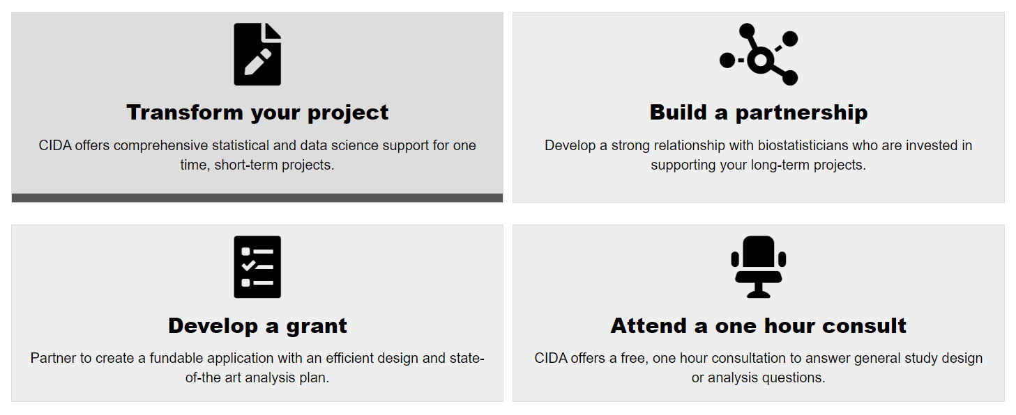
https://coloradosph.cuanschutz.edu/research-and-practice/centers-programs/cida/connect-with-us
Notes:
Camille

Slide 23
Thank you!
Questions? Please reach out!
camille.hochheimer@cuanschutz.edu
sarah.schmiege@cuanschutz.edu

Slide 24


Connect with us!
@CIDAstats
Center for Innovative Design and Analysis

